Slide 1

Geometry Algo
Anu yadav

Slide 2
Geometry Algo termed first coined by Marvin Minsky in his book perceptron, related to pattern recognition, to describe the algorithm for manipulating curve and surfaces in solid modelling.
Applications
CAD – computer aided design
Computer vision
Image processing
Robotics
GIS – geographical information system
Computer Graphics
VLSI design
Statistics

Slide 3
It is the study of algorithm to solve the problems in terms of geometry.
Goal : to provide basic geometric tools needed from which application area can then build their programs.
PRO:
Development of geometric tools
Efficiency proved
Correctness/Robustness
Linkage to discrete math's combo with geometry algo
Limitations
Discrete geometry
Flat objects
Low dimensional spaces

Slide 4
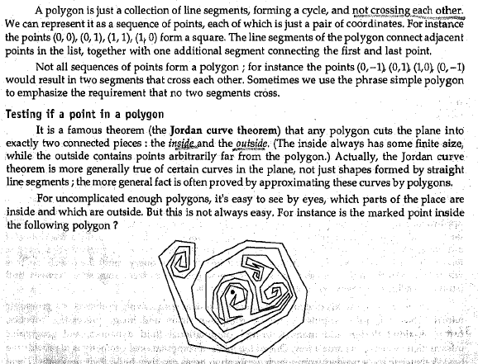
Polygons

Slide 5
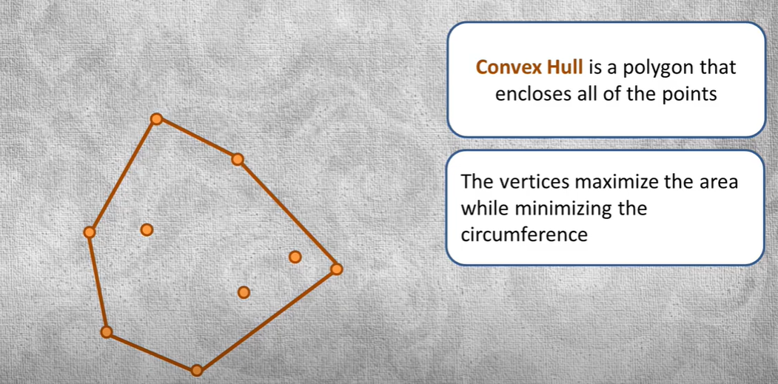
Convex hull

Slide 6
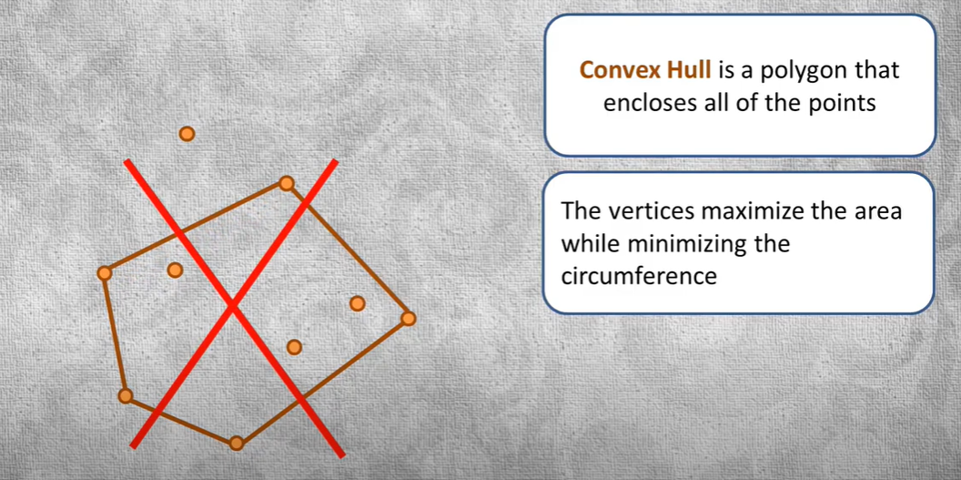

Slide 7
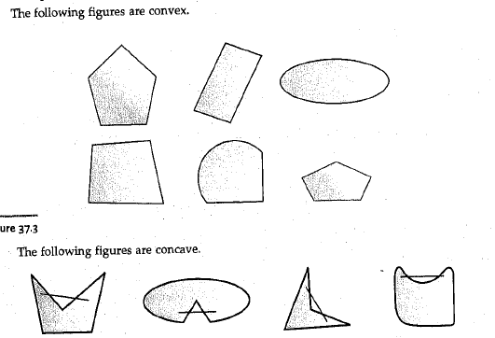

Slide 8
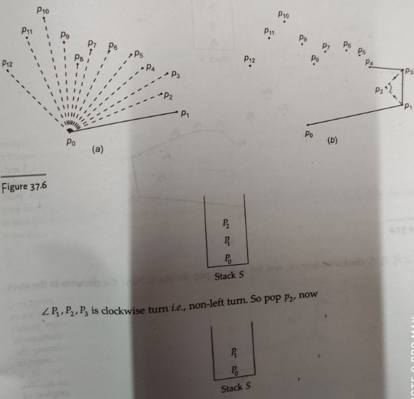

Slide 9
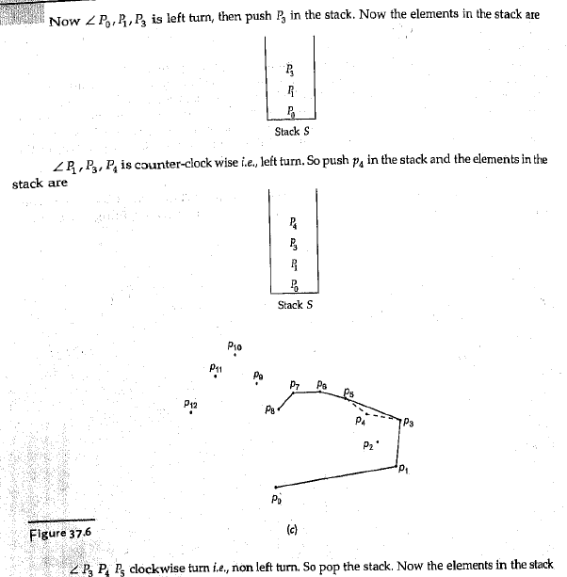

Slide 10
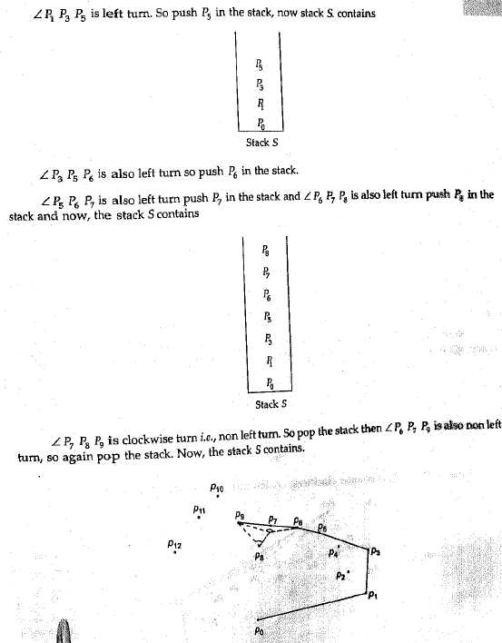

Slide 11
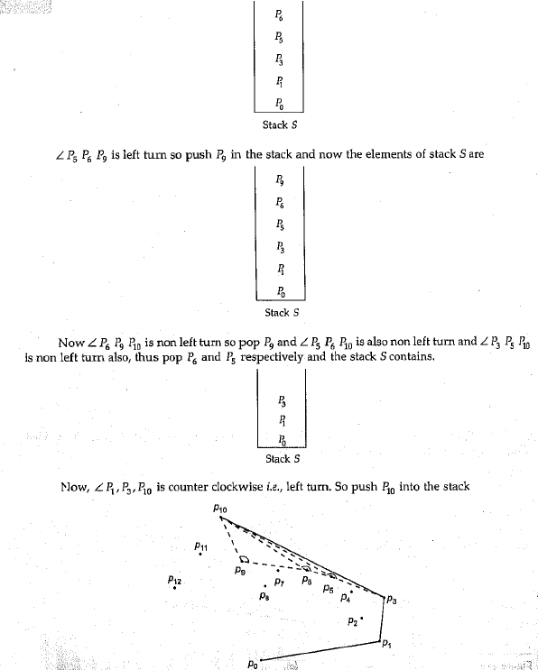

Slide 12
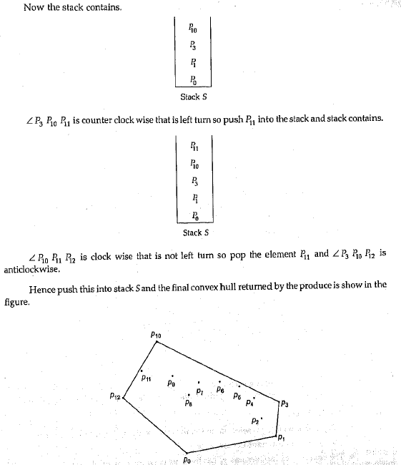

Slide 13
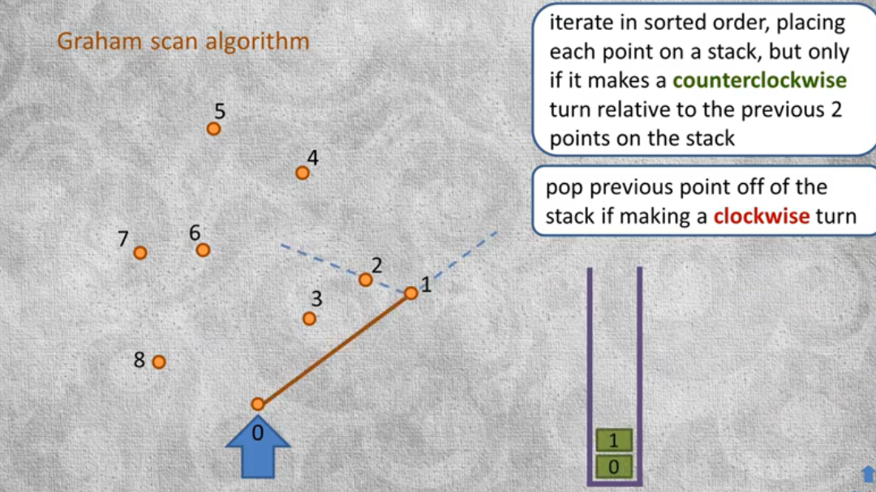

Slide 14
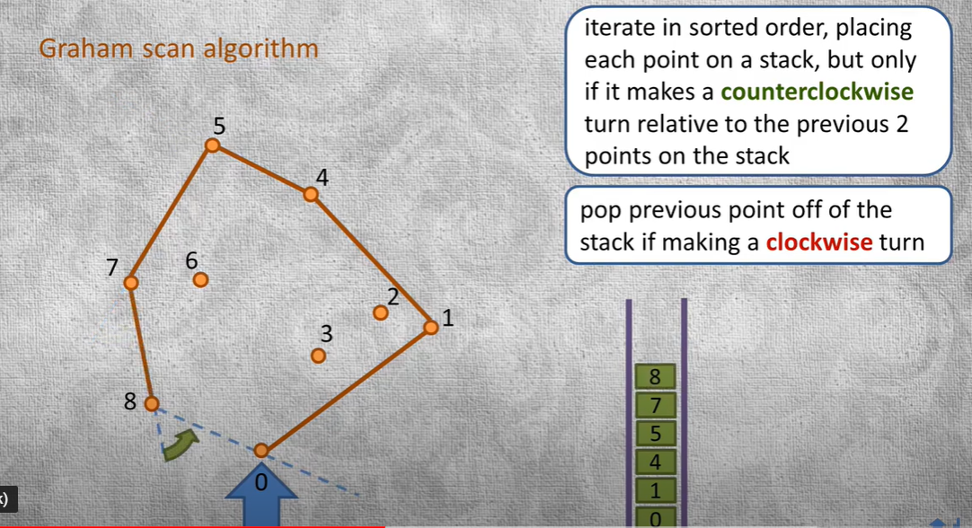

Slide 15
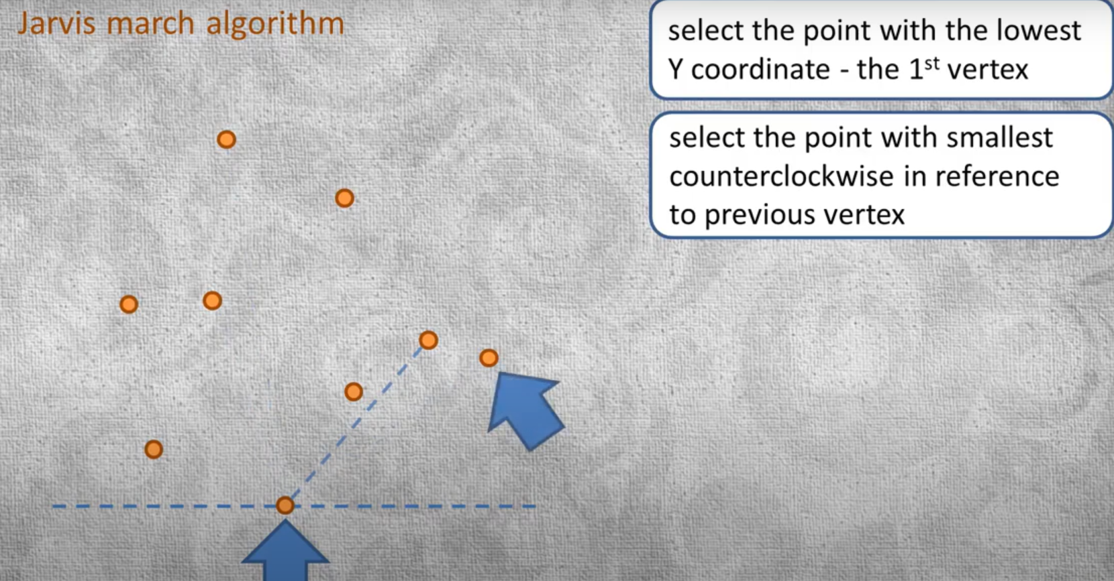
Jarvis march algo

Slide 16
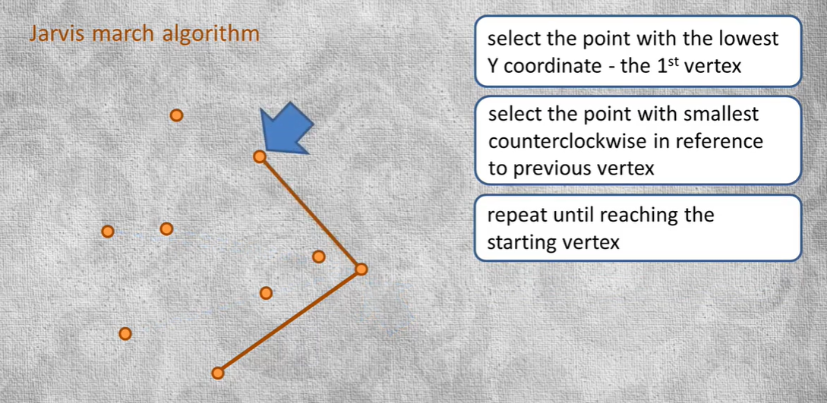
Cont.

Slide 17
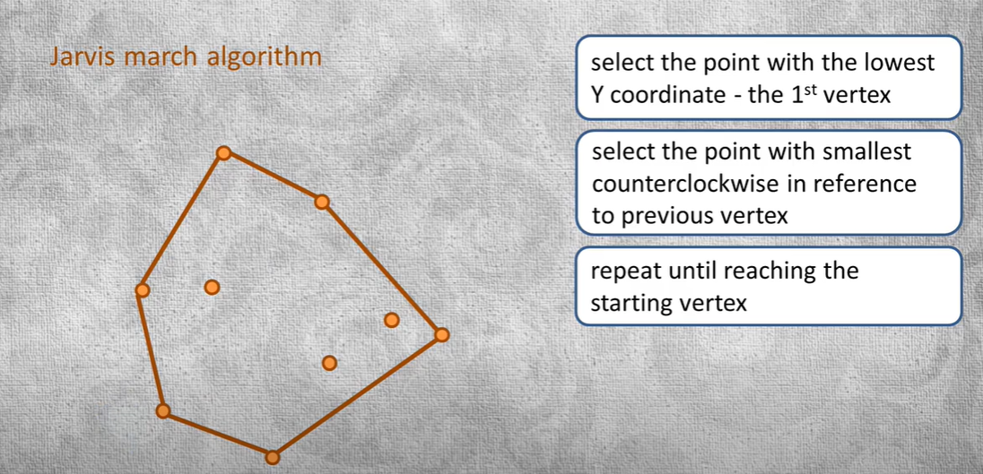
Cont.

Slide 18
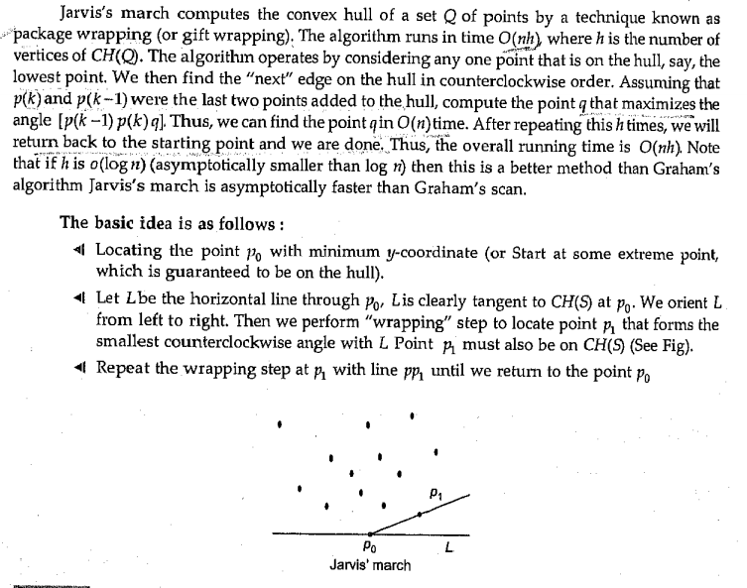

Slide 19
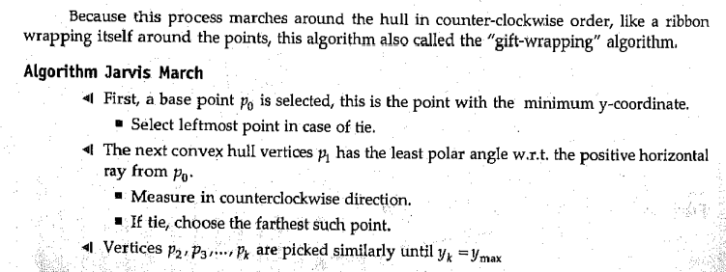

Slide 20
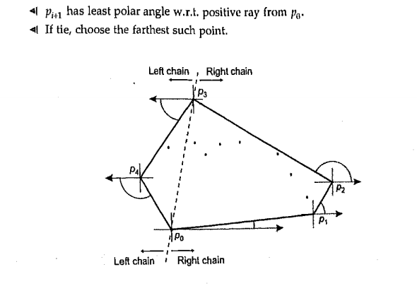

Slide 21
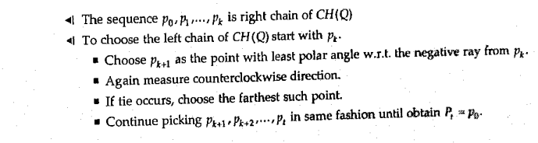

Slide 22
